Slide 1
Grabbed: Project Presentation
Team: Austin Branham, Stashaun Ashmore & Yetnayet Aberra

Slide 2
Overall Application Concept (Yeti)
This application allows the user to find a restaurant near by, check on wait times and make a reservation.
USER STORY:
As a user I want the app to find my location.
And show me restaurants conveniently located near me
I quickly want to see the address, zip code, price, website and information on wait times and link to make a reservations.
If I decide to make a reservation I want to be able to enter my personal information and book a table.
PROGRAMMING
This is a web-based mobile application, with the mobile first mindset that capitalizes on micro moments.
The user is prompted to allow Google API to find the user's location.
The google API location information is then passed through a YELP API Ajax call to identify the nearest restaurants.
Restaurant locations are displayed on google maps using Google's location marker
The user has the ability to book restaurant of choice.

Slide 3
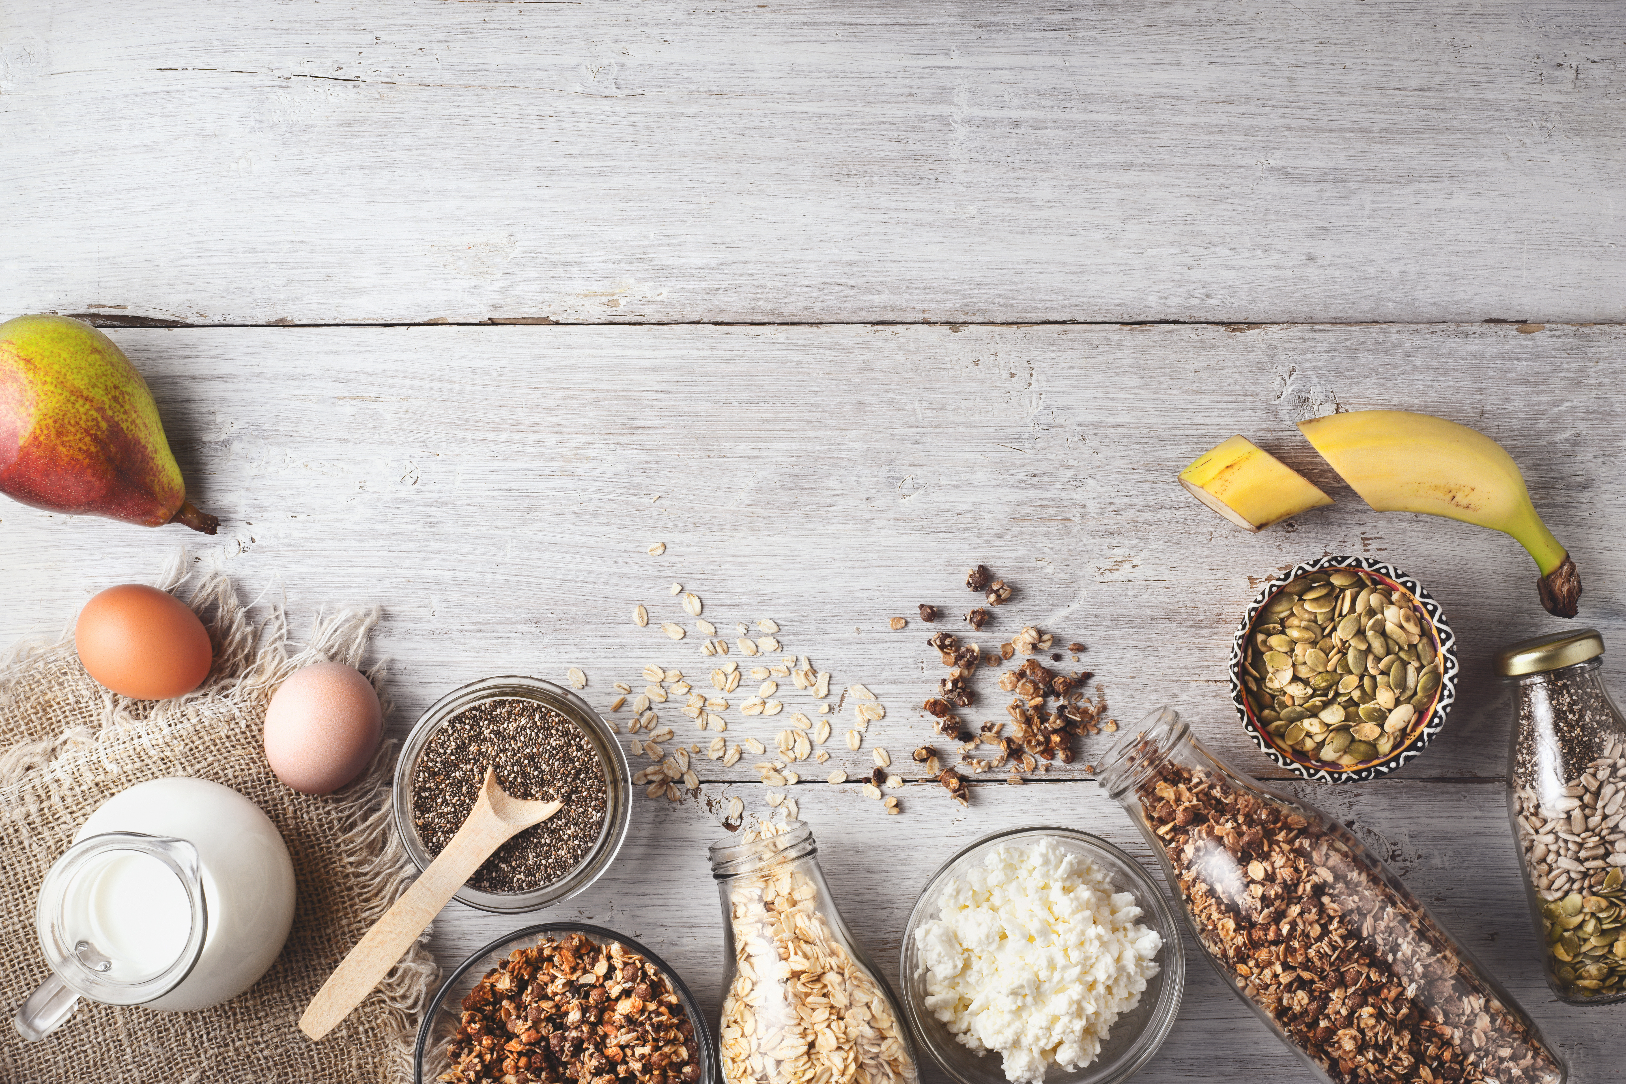
Motivation (Austin)
Nov 7, 2017, Google announced that it’ll have wait times for nearly a million sit-down restaurants around the world.
To access the feature, users just search for the restaurant on Google, open the business listing, and a Popular Times section will be displayed with an estimated wait in real time.
Disney wait time app not only shows you wait time in real time but helps you plan and reserve a spot.
Concept behind grabbed was to combine the ability to track on wait times in real time but also be able to make reservations ahead of time and cut on the wait times for seats at popular restaurants and hours.

Slide 4
Design: StaShun
Simple interface – with Grabbed Logo.
Google maps location display for user and location markers for nearby restaurant to user’s location.
Top Ten images and information displayed including restaurant name, address, phone number, rating website address and booking information
UI – results are displayed on same page with very minimal input to achieve the desired output of finding a location nearby, determine the wait times and book.
Device responsive- layout
Used bootstrap for CSS styling

Slide 5
A demonstration of its function Yeti
user opens the app that will display grabbed brand log and confirmation to access location of the user
If user confirms the app will access the location of the user
The google api uses longitude and latitude locators. This is passed through the Yelp API Ajax query to identify 15 restaurants close to the user's location.
We've defined the business listing as res in our function. We use the data to The app will use the database to access and store key elements - address, image, rating, address, price, website and booking.
The app will Display TOP 15 choices based on proximity to user.
Using the dot notation, we created variables to pull key elements from the business array and appended to the div in the html for display.

Slide 6
The technologies you used (and briefly how they work) StaShun
Google API
Yelp API
Google Location Marker
-

Slide 7
Directions for future development (Austin)
At moment no API available to gauge wait times in real time
Not all restaurants have online booking
Access to the Yelp API’s Seat Me reservation system takes 4 to 6 weeks approval.
Open table, reservation doesn’t synch up with the Yelp API businesses listings.
Utilize the google API wait times when it becomes available at the end of this year.
Access to Yelp API’s seat me reservation system.

